Slide 1
Data Service Workshop
Version 1.0

Slide 2
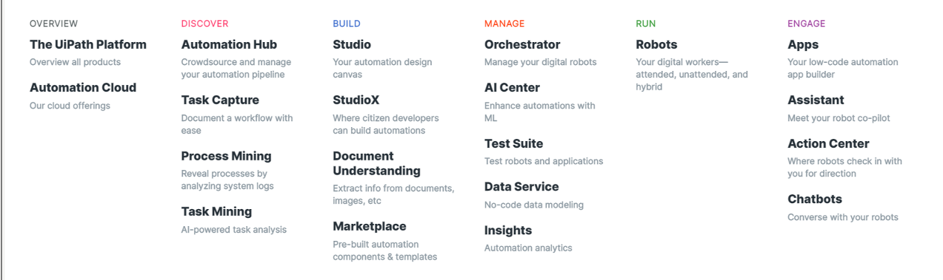
Agenda
All Angles (3 mins)
Demo 1.0 (5 mins)
Hands On (20 mins)
Avokudos Bounties (2 mins)
Reference

Slide 3














Business Analysis
All Angles
The Business User
The Independent Artist
Mentorships
Placements
Alyssa Garcia
Performances

Slide 4








Business Analysis
All Angles
Alyssa Garcia
Maintaining & Monitoring Socials
Time Consuming Work
Competing Approaches

Slide 5
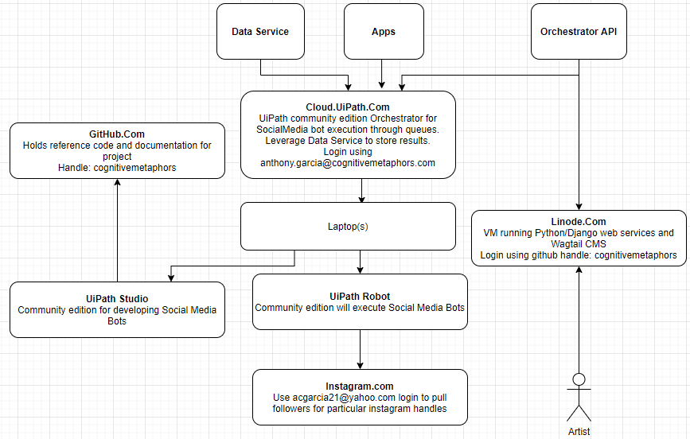
Project / Program Management
All Angles
Minimum Viable Product that...
Gives a basic understanding of Orchestrator - config file, scheduling, queue
Gives a basic understanding of a production ready UiPath Studio project including:
REFramework
Use of Queues
Selectors
Exception Handling
Retries
Workflow Analyzer for code review
Use of a code repository like Github and CI/CD

Slide 6
Development
All Angles
Production Considerations
Privacy / PHI
In Place Of Spreadsheets
Tool for Mentorship
Athena
Testing / Test Suite
Code Repositories
Github
Azure DevOps
Jenkins
Insights
Report widgets on queues
Experience Points
Avokudos

Slide 7
Development
All Angles
Limitations
15,000 calls per unattended license/day
Roughly 1 call every 5 seconds
Hard to hit that limit, but if you aren’t thinking when you code, it can happen
Consider keeping data service calls in performer, rather than having a separate performer for it
PII/Security
Be conscious of what you should/shouldn’t store in data service
Have clear conversations with customers regarding the matter

Slide 8
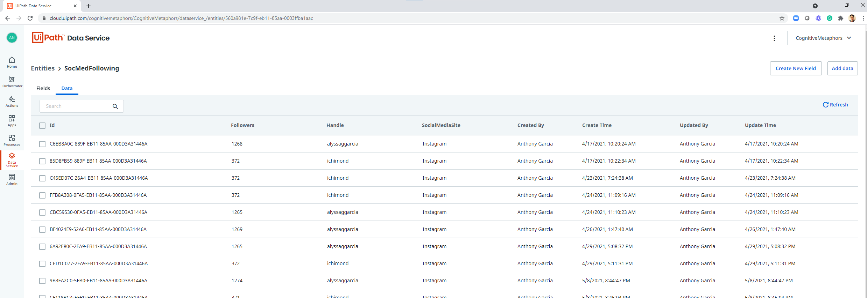
A minimum viable product for tracking social media follower growth.
Demo

Slide 9
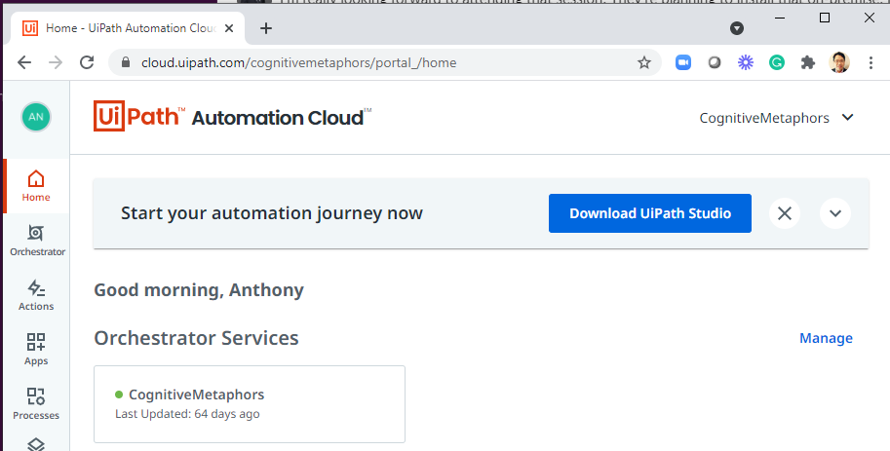
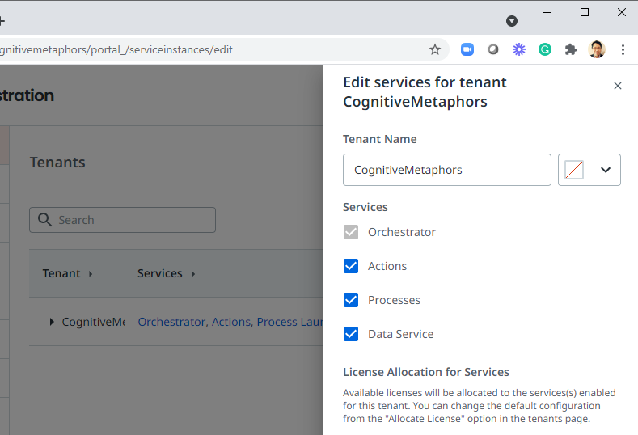
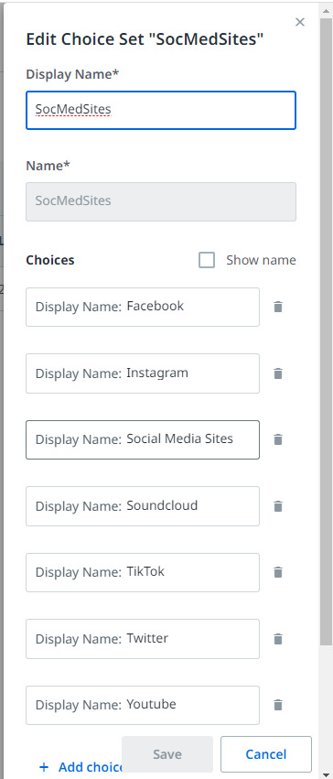
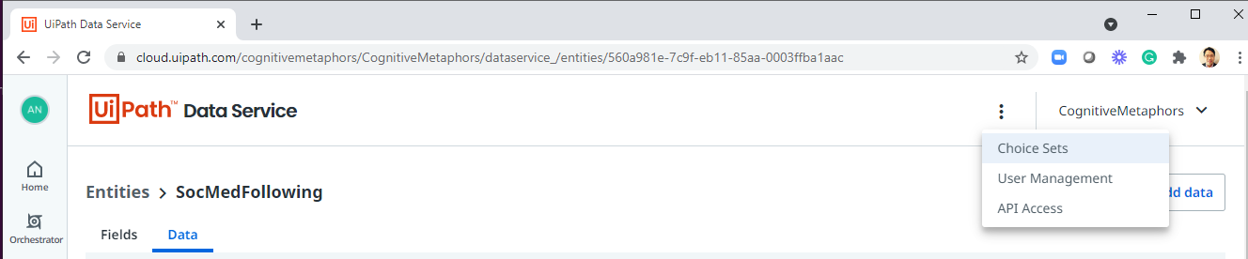
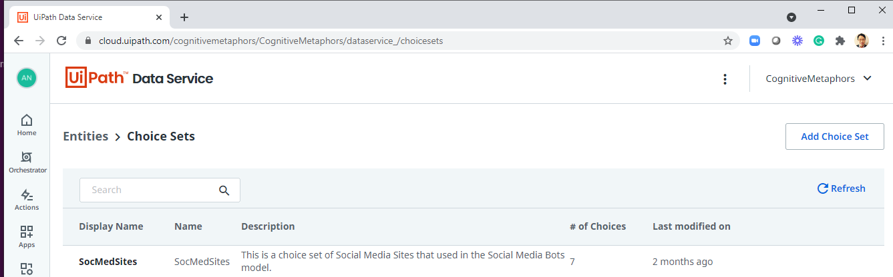
Orchestrator
Demo

Slide 10
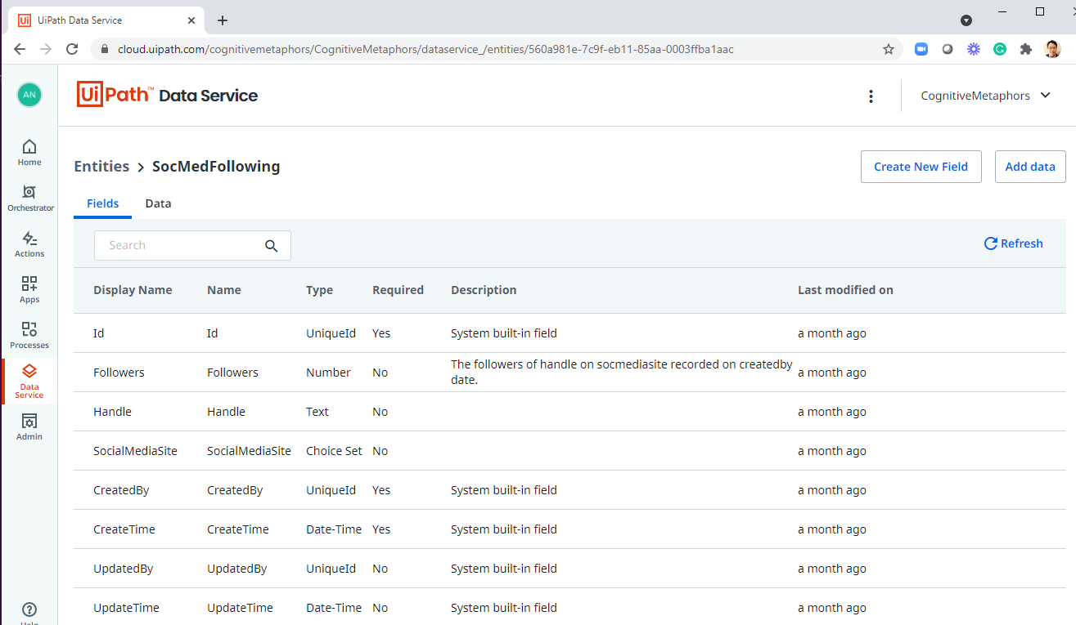
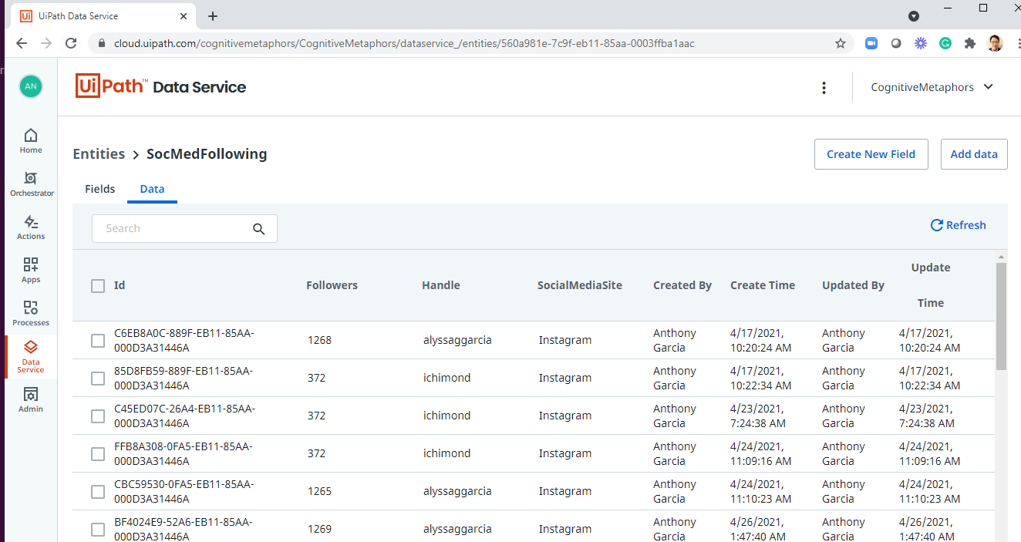
Orchestrator
Demo

Slide 11
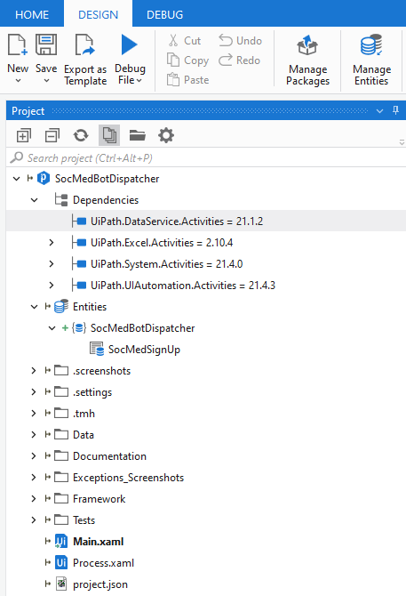
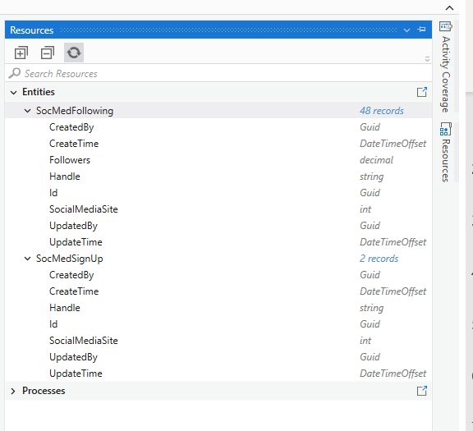
Dispatcher
Demo

Slide 12
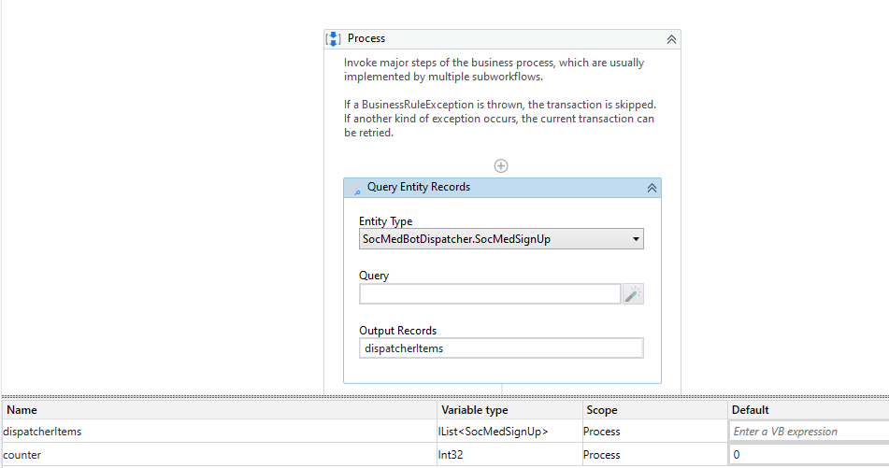
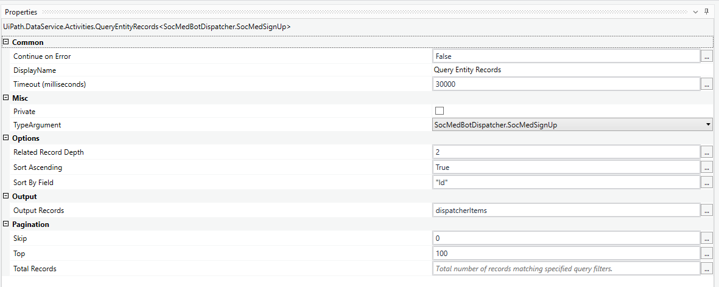
Dispatcher
Demo

Slide 13
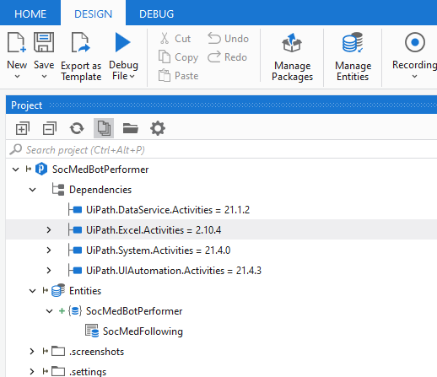
Performer
Demo

Slide 14
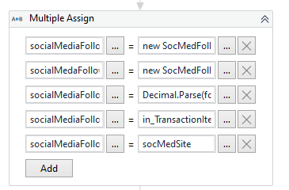
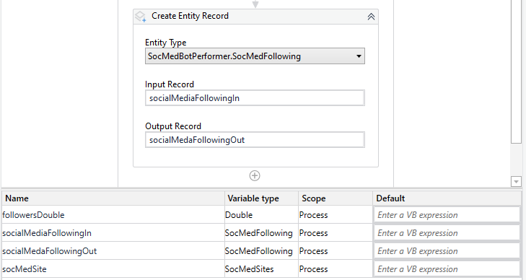
Performer
Demo

Slide 15
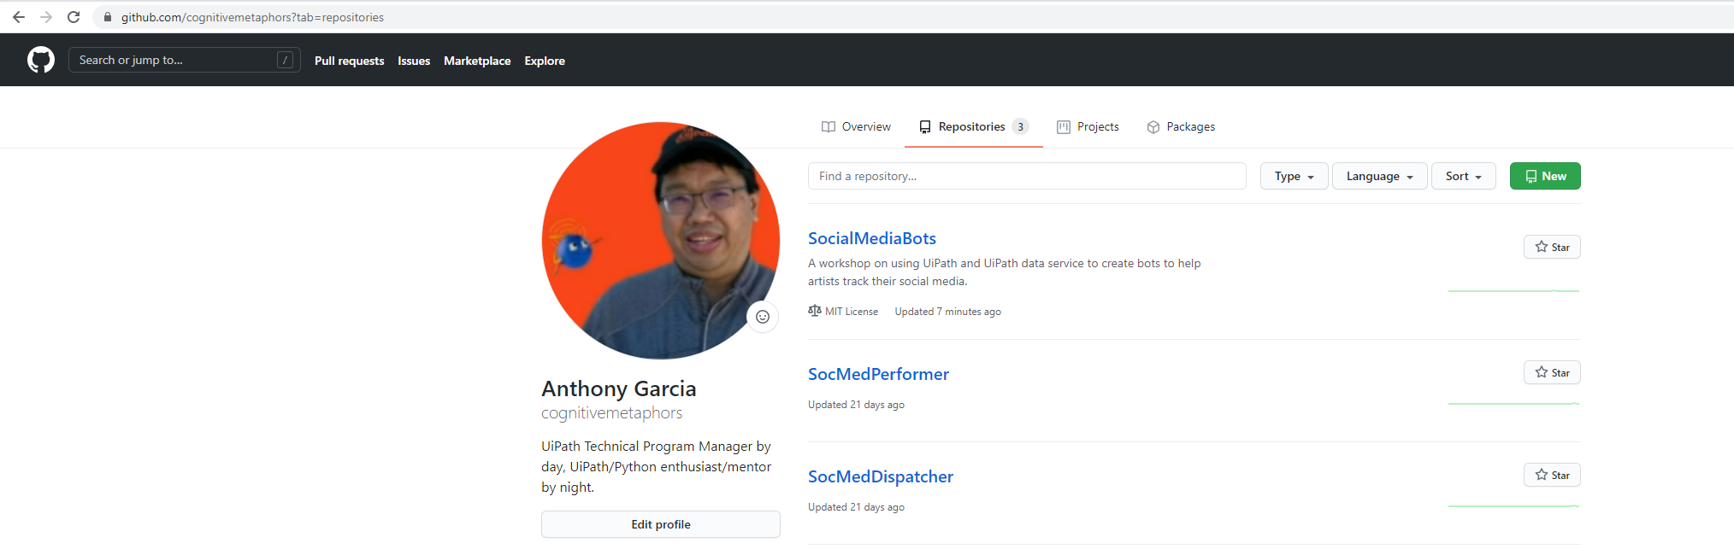
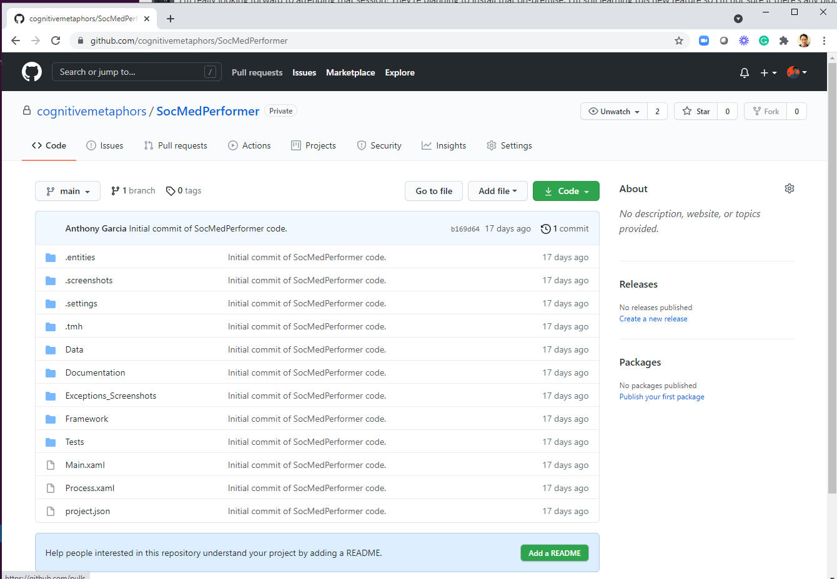
GitHub and Orchestrator Deployment
Demo

Slide 16
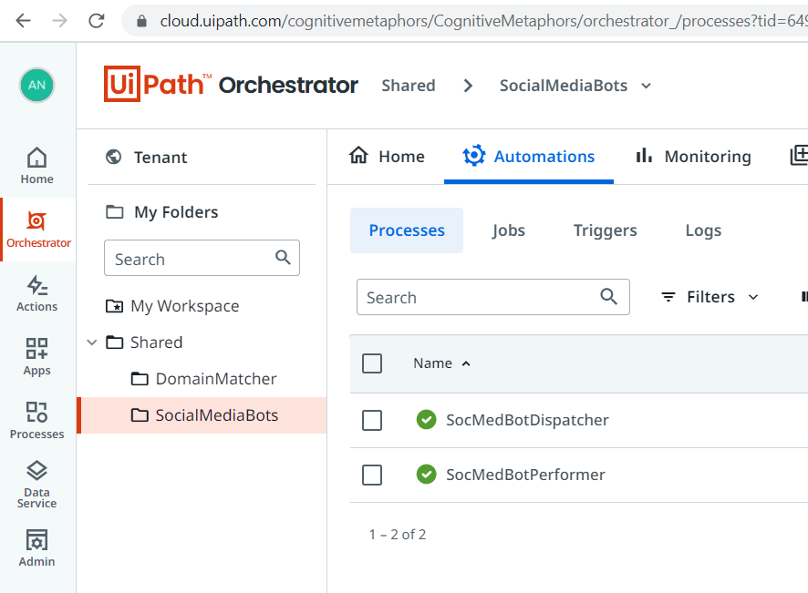
Orchestrator Deployment - Processes
Demo

Slide 17
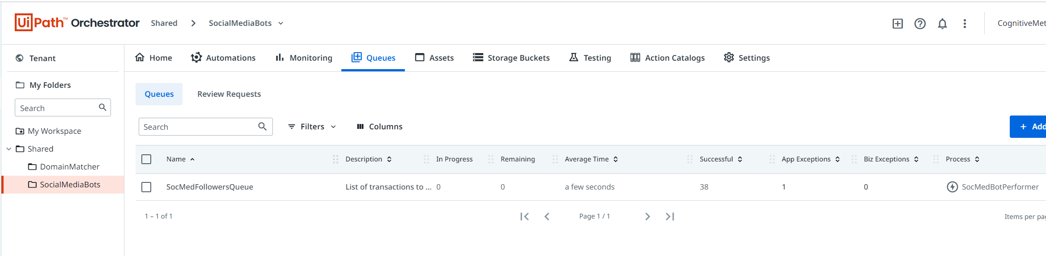
Orchestrator Deployment - Queue
Demo

Slide 18
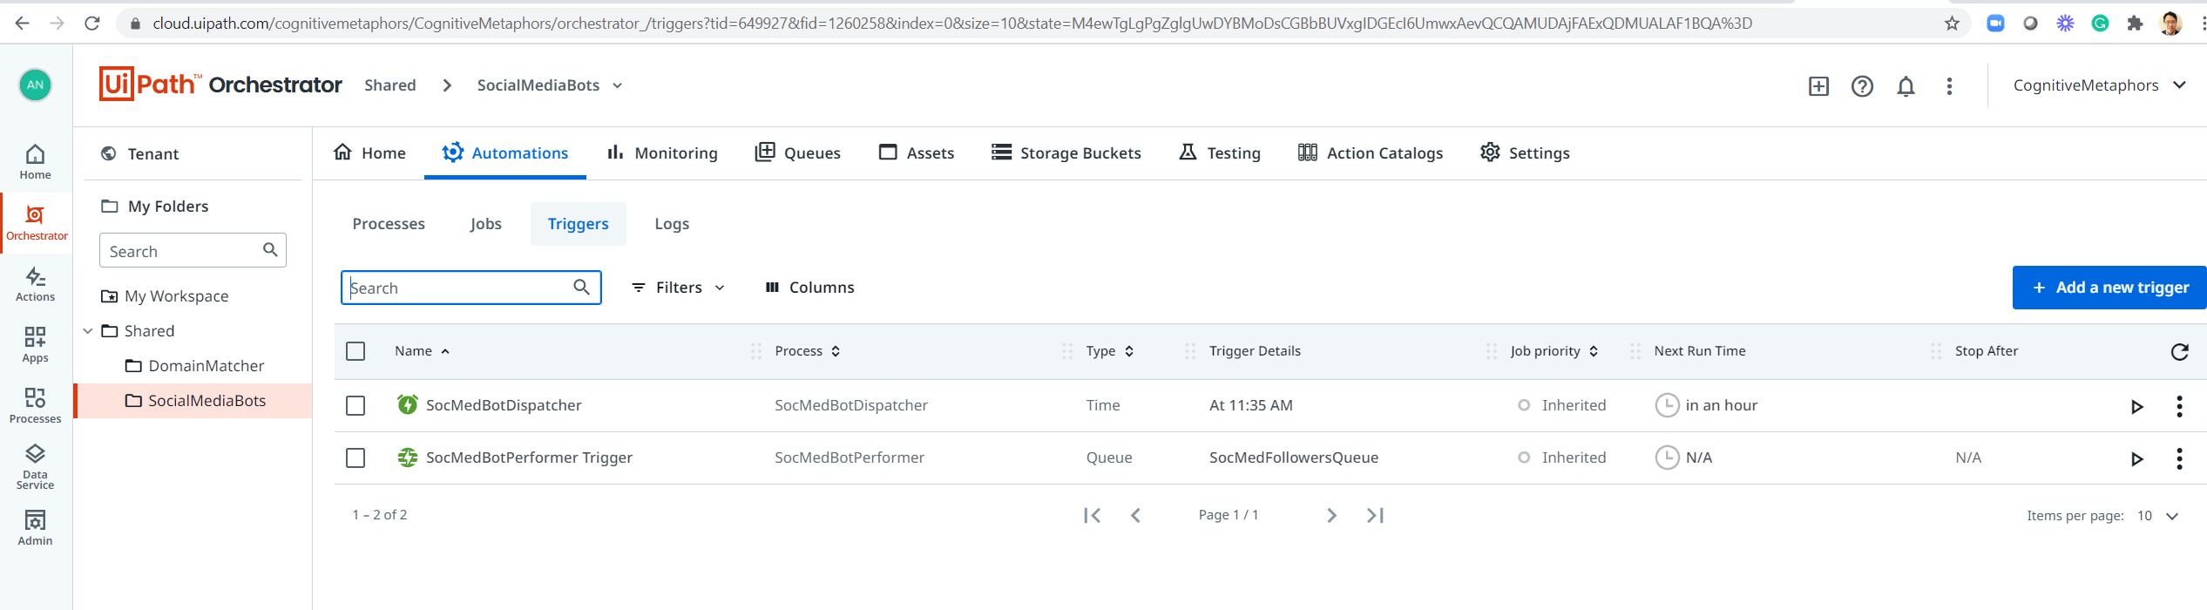
Orchestrator Deployment - Triggers
Demo

Slide 19
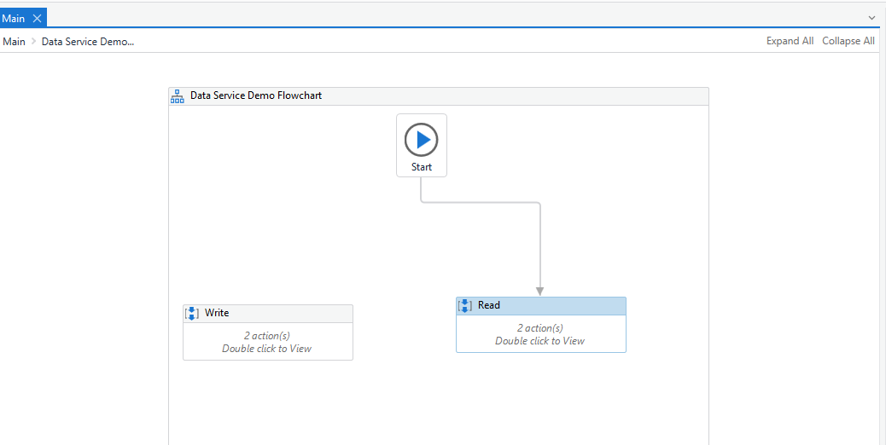
Setup, Read, Write To Data Service (see instructions in Powerpoint Notes)
Hands On Workshop
Notes:
DATA SERVICE WORKSHOP (https://github.com/cognitivemetaphors/SocialMediaBots)
CHOICE SET
PREQUISITE - Set up Data Service,2 Tables, 1 Choice Set
Topic: Data Service Preparation For Friday's Workshop
Start Time : Jun 2, 2021 02:13 PM
Meeting Recording:
https://uipath.zoom.us/rec/share/dX9I40b-ZvKQa8vbNx9A6mE85Oas-sjvBIqiFQOwMW8q87xiRKFbn3p7BphtE7m9.yng3BytLqYmBpICi
Access Passcode: gV*9E.yu
STUDIO SETUP
1. Connect UiPath to your cloud.uipath.com account that you turned the data service on for.
2. Open a new project in studio.... I call mine SocMedBotWorkshop
3. Click on right hand Resources Panel. You should see the 2 tables you created: SocMedFollowing and SocMedSignup
4. From the resources panel, drag SocMedSignup under the Entities section of the Project Panel
5. A Manage Entities window comes up. Click OK.
6. Click on Manage Packages
7. Add in UiPath.DataServiceActivities
8. Click Install. Click Save.
9. Drag a Flowchart activity and 2 blank sequences. Rename one sequence Write and one sequence Read.
10. Create a global variable and name it entry.
11. For the type, search for SocMedSignup, select it, and click Ok
WRITE
12. In the Write sequence, add a Multiple Assign activity
13. In the 1st slot, put entry on the left hand side
14. In the right hand side of the 1st slot, type new SocMedSignUp (you should see intellisense pick it up)
15. click Add twice to add two more slots.
16. In the 2nd slot, put in entry.Handle on the left hand side.
17. In the 2nd slot, put "<social media handle of your choice>" on the right hand side
16. In the 3rd slot, put in entry.SocialMediaSite on the left hand side.
17. In the 3dd slot, put on the right hand side put SocMedSites.Twitter (or you can choose a different type after the dot)
18. Drag in a Data Service activity called Create Entity Record
19. Change the Entity Type to SocMedBotWorkshop.SocMedSignUp
20. For the input record use the entry variable
21. For the output record - hit Contrl-K in the variable field and type in returnedEntry + <enter>
READ
22. In the Read sequence, add a Query Entity Record
23. Choose the SocMedSignUp entity type
24. In Output Records, hit Cntrl-K and type signUpList
25. Create a Read scope variable called counter of type Int32
26. Add a For Each activity
27. In the "in", type in signUpList
28. In the For Each body, add a Log Message activity
29. Change the TypeArgument property of the For Each loop to SocMedBotWorkshop.SocMedSignUp
30. In the Log Message, type item.Handle + "," + item.SocialMediaSite.ToString
Demo
31. You can switch the start arrow of the flow chart to test Write or Read

Slide 20


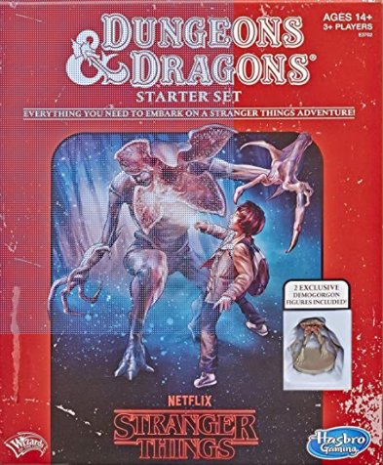

Avokudos Bounties
Gaining Experience
Differentiate from Hootsuite +2
Interview An Artist And Develop One PDD Level Requirement +4
Add Another Social Media Conter and Commit Branch +2
Slack App To Intercept Bounty Items By Tag +10
Business Analysis
Differentiate from Social Blade +2
Write a UAT Test Case for One PDD Level Requirement +4
Python API Script To Set Up Starting Data Service Tables +2
Slack App To Create Product Family Scorecard / Report +10
Project Management
Walk Through SocMedBot Orchestrator With A Dev +2
Buid PDD For Another Product Family Module +10
Implement New PDD Level Requirement +2
Automation To Receive Email and Return Followers Report +2
Development
Walk Through GitHub Branch/Merge With A Dev +2
Job Aid For Common Best Practice i.e. Github Code Branch/Merge +5
Expand DS Workshop To Include Relationships +2
Monitor Failed Queue and Handle Exception With New Code +2
Tags
#Product Family
#Data Service
#Development
#BusinessAnalysis
#ProjectManagement
Run Workflow Analyzer And Address Any Corrections +2
Walk Through ReFramework With A Dev +2
Plan Another Product Family Module +10
Walk Through Workflow Analyzer With A Dev +2
Insight Widget Based On SocMedBot Queue+2

Slide 21
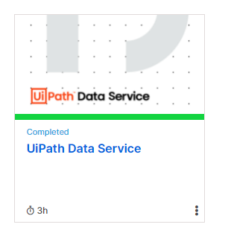
Reference
This video will show you some of the structures ( I need 2 tables created in Data Service ) that you will need. Topic: Athena - Studio Mentoring Start Time : May 14, 2021 07:00 AM - Meeting Recording: https://uipath.zoom.us/rec/share/fmbQ-szKBogzPM6eGdjm3bnHvXeJBrRh6A3XPcJznYzYrsrUxhzO8mgselsL1aVZ.BE0ejGiMT7SLlknh Access Passcode: 1Ny!CHe#
This video shows how to move a UiPath project to github.
Topic: Move A UiPath Project To GitHub Date: May 13, 2021 08:05 AM Eastern Time (US and Canada)Meeting Recording: https://uipath.zoom.us/rec/share/vTtZG6SRqfbbNRueUgYmLpcZgerXW7-eUV2OwWVQ94ke4kJkEEqseQ7rMkm6_ktg.K7U-M9-EYpxbrUr0 Access Passcode: *y99.=Xu
Workshop Slides
https://github.com/cognitivemetaphors/SocialMediaBots
Base Code
https://github.com/cognitivemetaphors/SocMedPerformer
https://github.com/cognitivemetaphors/SocMedDispatcher
Guidelines On Data Privacy
https://uipath.atlassian.net/wiki/spaces/LEG/pages/edit-v2/1874264894
Academy.UiPath.Com Course

